Slide 1


FlixBus Twitter Analysis
FLiXBUS Twitter Search Data Processing
Mikhil Nagarale
FLiXBUS Twitter Search Analysis

Slide 2
Data Processing Pipeline Steps
Search Tweets with hashtag #FlixBus from last week using ‘Twitter Standard Search API’ using requests library in Python.
Storing the raw data in JSON format.
Transforming the raw data using json library in Python.
Extracting required data from every tweet.
Enabled logs using logging.
Configuration parsing using configparser library in Python.
Tweet search on specific date range (Added code. Available only in ‘Twitter Premium search API’ & ‘Twitter Enterprise Search API’.
Script argument parsing using argparse library in Python.
Job Scheduling using Airflow.
Copying of processed data in HDFS.
Loading of processed data in Hive managed table. argparse

Slide 3
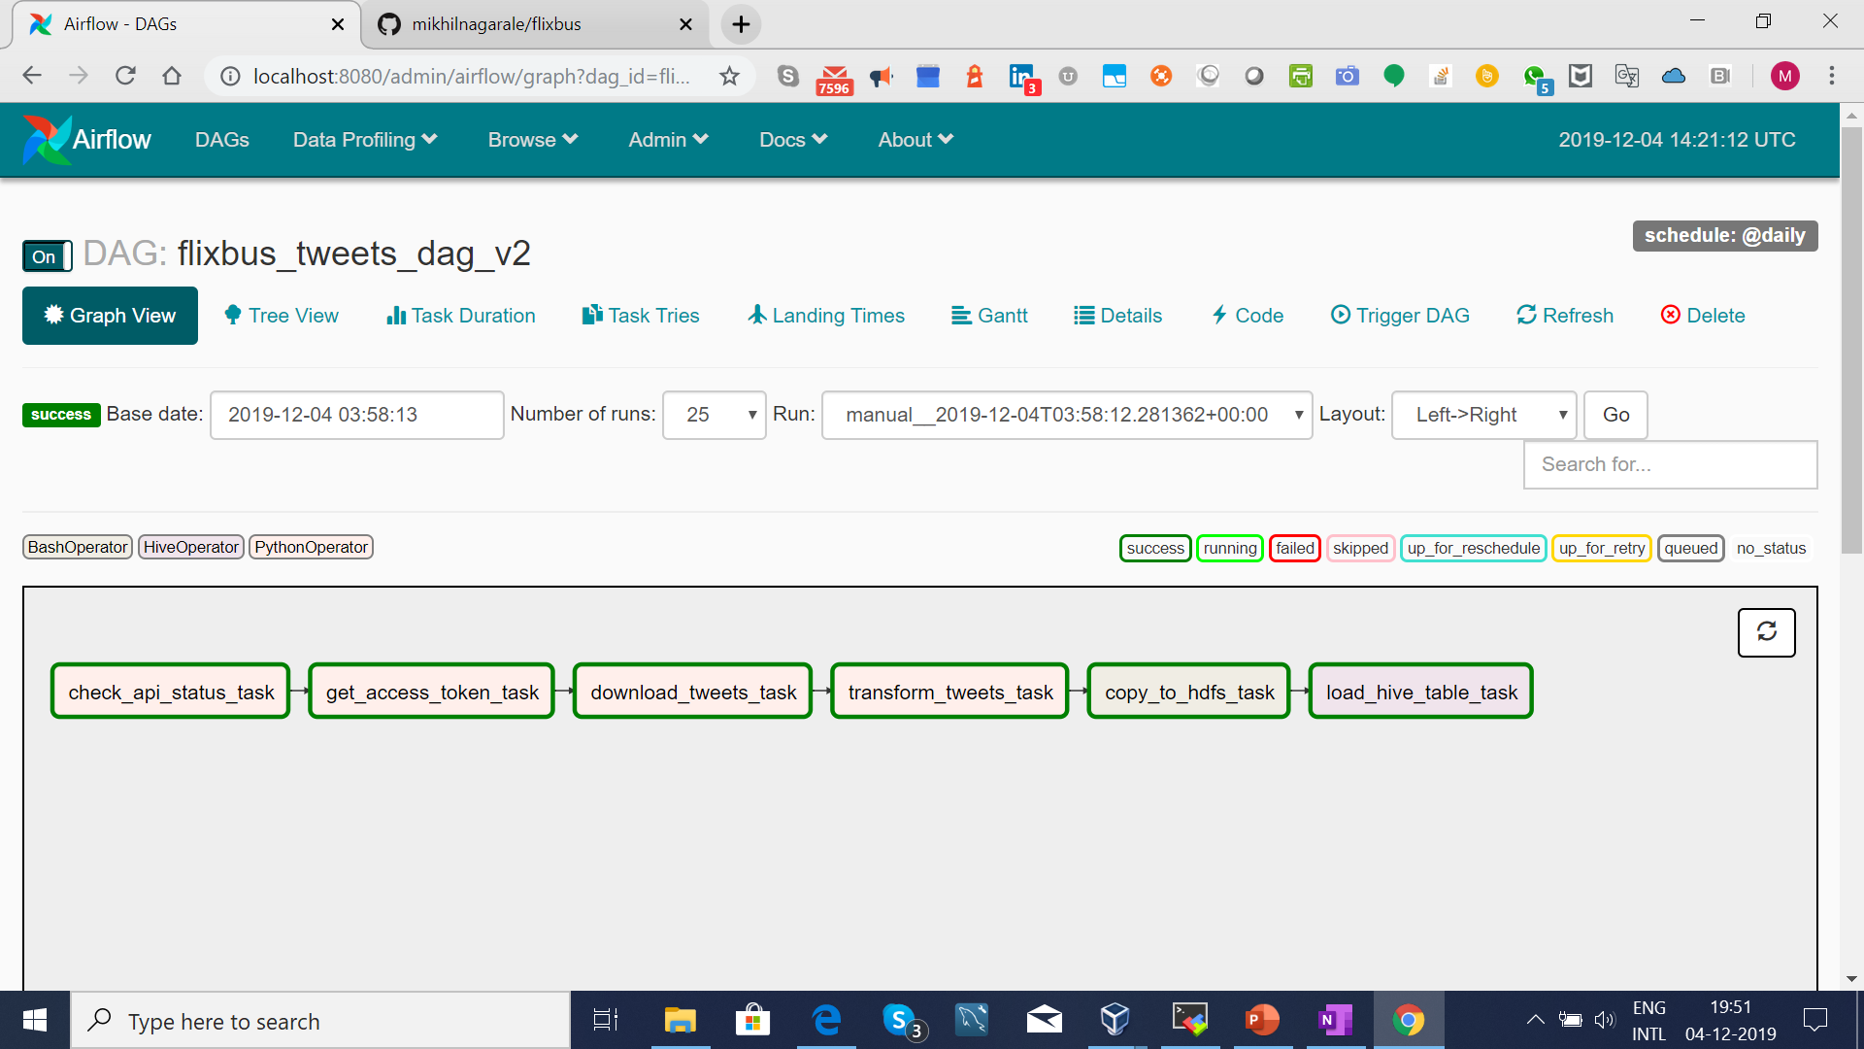
Airflow Dag

Slide 4
Steps Followed for creating Pipeline & ETL process.
Pipeline has three parts
Getting data from Twitter – I’ve referred Twitter Standard Search API & App only Authentication documentation.
Store Processing data – Used Python json package for parsing JSON response from Twitter Search API.
Scheduling Job for automated processing – Used Airflow for scheduling the job.

Slide 5
Improvements
We can enable email alerts by configuring smtp for job failure & retry in Airflow DAG.
We can create Operator for checking API availability.
Airflow can be used to process task in distributed mode using celery & rabbitmq.
We can create data pipeline for multiple sources like Databases, Files, Tweets, Facebook posts, LinkedIn Posts, Bus Sensor data, User App Data, Weather Data, Location Data.
Once data is available in Data Lake then we can use it for Analysis to decide optimize route for buses & to give budget price for users.
We can also use this data for marketing promotions to users.

Slide 6
Dream Infrastructure
A cluster with 4-6 nodes.
Each node will have 32 GB RAM & 500 GB HDD/SSD.
Airflow will be used as Data Pipeline/ Scheduling tool.
For Data Processing we can use Spark.

Slide 7
Thank You !

